Slide 1
Fiscal Responsibility for Special Education Under IDEA
Every Child. Every Chance. Every Day.

Slide 2
Important Fiscal Acronyms
CEIS Coordinated Early
Intervening Services
EDGAR-Education Department General Administrative Regulations
GEPA-General Education Provisions Act
LEA-Local Education Agency
LRE-Least Restrictive Environment
MFS-Maintenance of State Financial Support
MOE-Maintenance of Effort
OMB-Office of Management and Budget
OSEP-Office of Special Education Programs
PAR-Personnel Activity Report
SEA-State Education Agency
UGG-Uniform Grant Guidance
Notes:
Acronym reference

Slide 3
Presentation Objectives:
Explain special education services
funding under IDEA provided for children
with disabilities (ages 3-21)
Provide an overview of fiscal laws and
guidelines for receiving federal special
education funding at the state education
agency (SEA) and local education agency
(LEA)
Provide an overview of eGAP 2.0

Slide 4
IDEA
The Individuals with Disabilities Education Act (IDEA) is a United States federal law that governs how states and public agencies provide early intervention, special education, and related services to children.
34 CFR 300

Slide 5
Federal Regulation
Establishes central responsibilities of states, local
education agencies, and schools
Creates a grant program that funds special education
and related services in public schools for children ages 3-21

Slide 6
Special Education must adhere to the following:
Regulations and Requirements
Individuals with Disabilities Education Act (IDEA)
Elementary & Secondary Education Act (ESEA)
Every Student Succeeds Act (ESSA)
Education Department General Administrative Regulations (EDGAR)
Alabama Administrative Code (AAC)
Alabama State Purchasing Laws
LEA Written Policies and Procedures

Slide 7
13 Disability Categories Under IDEA
Autism (AUT)
Deaf-Blindness (DB)
Developmental Delay (DD)
Emotional Disability (ED)
Hearing Impairment (HI)
Intellectual Disability (ID)
Multiple Disabilities (MD)
Orthopedic Impairment (OI)
Other Health Impairment (OHI)
Specific Learning Disability (SLD)
Speech or Language Impairment (SLI)
Traumatic Brain Injury (TBI)
Visual Impairment (VI)
Special Note: 504 nor Gifted is an IDEA disability category.

Slide 8
Parts of IDEA
Part A - serves as the foundation for the law and does not have a grant associated with it.
Part B - provides educational guidelines for children with disabilities ages 3-21.
Part C - provides guidelines concerning the services to children from birth through 2 years of age (i.e., up to 36 months or their 3rd birthday) as well as their families.
Part D - provides for formula grants that are intended for national activities and provides funding to improve the education of children with disabilities. These activities include grants to improve the education and transitional services provided to students with disabilities, in addition to resources to support programs, projects and activities which contribute positive results for children with disabilities. Example: State Personnel Development Grant (SPDG)- CFDA: 84.323

Slide 9
IDEA Sources of Funding for Special Education
US DOE-OSEP grants IDEA Part B funds to the ALSDE
ALSDE subgrants to LEAs:
IDEA Part B, Allocations
IDEA Preschool Allocations
AL High-Cost Fund (ALHCF) Set-Aside
Notes:
IDEA Sources of Funding for Special Education
OSEP, provides formula grants to states to assist in providing FAPE in the least restrictive environment for children with disabilities ages 3-21.
Each year Alabama receives grants under Part B (Section 611) & Preschool (Section 619) of the IDEA. After setting aside necessary and allowable amounts for state level activities, the ALSDE must allocate the remainder of the grant as flow-through sub-awards to LEAs.

Slide 10
Grants Under IDEA
IDEA Formula Grant
Part B, IDEA - OSEP, provides formula grants to states to assist in providing FAPE in the least restrictive environment for children with disabilities ages 3-21.
Regular: Section 611, AL Fund Source 3210 (ages 3-21)
Preschool: Section 619, AL Fund Source 3220 (ages 3-5)

Slide 11
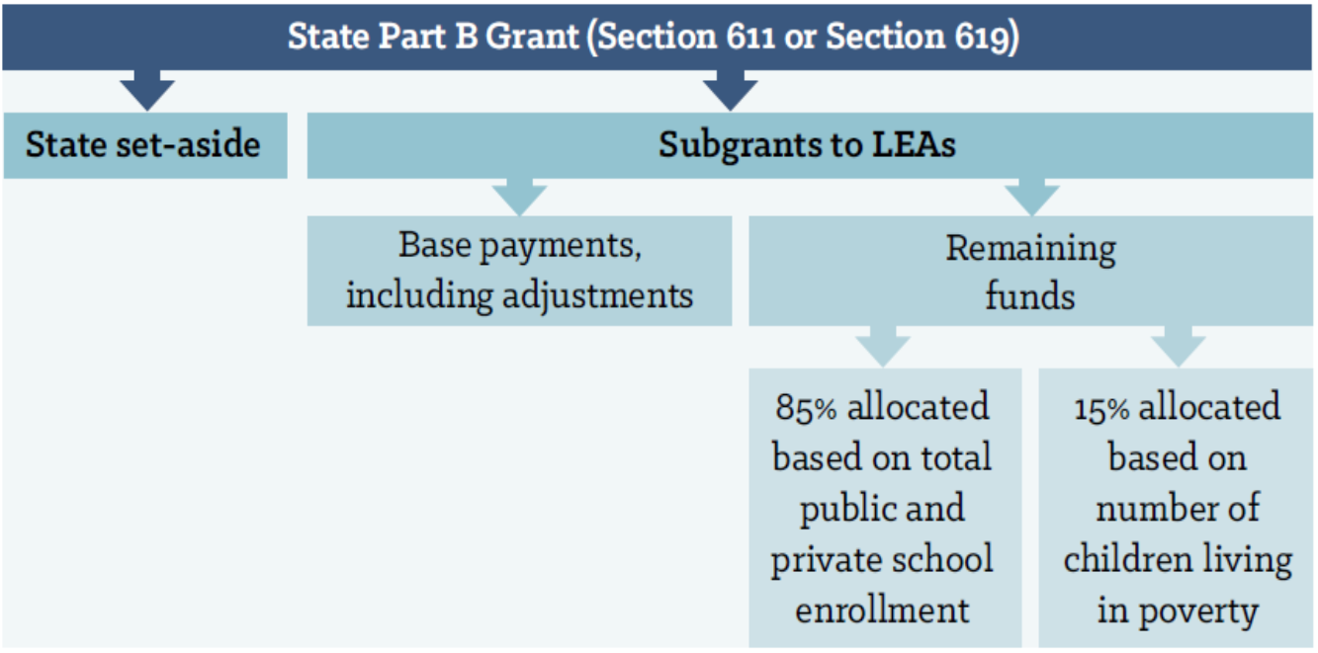
Framework of the IDEA LEA Allocation
How allocations (subgrants) are distributed to LEAs:
Notes:
This table shows a visual of how Part B funding is distributed.

Slide 12
Formula Used For IDEA Funds Allocations
LEA Base Payment Calculation (Child Count):
IDEA Part B (Section 611) Grants base uses - FY1999 data
IDEA Preschool (Section 619) Grants base uses - FY1997 data
Calculation Remaining of the Amount After Base Payment:
85% Based on Population [i.e., Average Daily Membership (ADM)]
Numbers are based on children enrolled in public and private
schools within the LEA’s jurisdiction
15% Based on Poverty (Eligibility Direct Certification Count)
Numbers are based on children living in poverty as determined
by SEA
34 CFR 300.704(b)

Slide 13
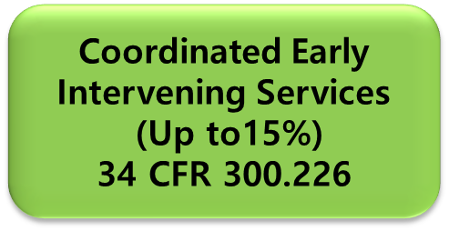
Use of IDEA Part B Funds LEA Level IDEA Part B Allocation Set-Asides:
Equitable Participation Services Set-Aside
(Proportionate Share)
34 CFR 300.133
LEA Administration
General Parameters
(Necessary, Reasonable, Allocable)
34 CFR 300.202
Notes:
Once the LEA receives their allocation, there are three set-asides that must be reviewed and determined if they are applicable to the allotted funding.
Read slide…

Slide 14
Federal Regulation EDGAR
US-Education Department General
Administrative Regulations
http://www2.ed.gov/policy/fund/reg/edgarReg/edgar.html

Slide 15
EDGAR Regulations Include:
Audit Rules Governing All Federal
Grants
Office of Management and Budget
(OMB)
Uniform Grant Guidance (UGG)
Revised Administrative Requirements
Cost Principles

Slide 16
What is the purpose of EDGAR?
Provides administrative requirements and oversight for ALL federal grant funds, to reduce the risk of waste, fraud and abuse
When monitoring the state and LEAs for compliance, auditors use EDGAR as a guide to ensure written policies and procedures provide effective internal controls
Grantees must have internal controls with written procedures for determining the allowability of costs charged to federal grants (200.302(b)(7))
Failure to comply with EDGAR could lead to potentially repaying disallowed costs to the Education Department with non-federal funds

Slide 17
EDGAR Grants Management Systems
Inventory Management
Financial Management
Procurement
EDGAR

Slide 18
EDGAR Required Policies and Procedures
Written Allowability Procedures
Written Cash Management Procedures
Written Conflict of Interest Policy
Written Procurement Procedures
Written Procedures for Managing Equipment
Written Time and Effort Policies and Procedures
Written Method for Conducting Technical Evaluations of Proposals and Selecting Recipients

Slide 19
IDEA & EDGAR Regulations must be used together!!

Slide 20
Use of IDEA grant funds
must comply with EDGAR!
For example:
EDGAR permits attorney’s fees to be expensed under certain circumstances (2 CFR 200.435).
However, IDEA states that Part B funds may not be used to pay attorney’s fees or costs of a party related to action or proceeding under section 615 of the Act and subpart E [Procedural Safeguards] of the regulations (34 CFR300.517(b)). Therefore, IDEA funds may not be used to pay attorney’s fees.

Slide 21
IDEA Fiscal Requirements
Excess Cost
Allowable Cost
Proportionate Share for Equitable Services of
Parentally Placed Private School Students with Disabilities
Comprehensive Coordinated Early Intervening Services (CCEIS)
Maintenance of Effort (MOE)
Supplement not Supplant
Notes:
Overview the IDEA Fiscal Requirements associated with receiving IDEA Part B funding

Slide 22
IDEA Requirement Excess Cost
“Excess cost” are those costs incurred in excess of the average annual per-student expenditure in an LEA, during the preceding school year for an elementary or secondary school student.

Slide 23
IDEA Requirement Allowable Costs
For a cost to be allowable, it must be:
Necessary-Is the expense necessary for the performance of the administration of the IDEA grant?
Reasonable- Is it a fair rate that can be proven and defended?
Allocable- Is the cost in proportion to the value received and can only be for the benefit of special education?

Slide 24
Allowable Costs: Documentation
Includes the following:
clear and adequately documented expenditures
the amount and exactly how the funds are used
the total cost of the project
records showing performance and compliance to assist with facilitating an effective audit
Statute of Limitations: Retain Documents for 5 years
**Special note: Alabama’s fiscal is 5 yrs plus 1 yr = 6 years Due to Alabama’s different fiscal and academic years.
Notes:
The allowable cost requirement includes adequately documented expenditures. READ slide….

Slide 25
IDEA Requirement Parentally Placed Private School Students with Disabilities
Component 1: Programs
Equitable Services
Program Provided
Special Education
& Related Services
Component 2: Funding Proportionate Share
Funding Equitable Special Education Services

Slide 26
IDEA Requirement
Private School Proportionate Share for Equitable Services
Ensure LEAs properly determine and set-aside the proportionate share of IDEA funds to be spent on equitable services for parentally-placed private school students with disabilities.

Slide 27
IDEA Requirement Comprehensive Coordinated Early Intervening Services
REQUIRED: CCEIS requires LEAs identified as having significant disproportionality to reserve the maximum (15%) amount of the total IDEA funds allocated. This includes the Part B, IDEA (611) allocation-FS 3210 and IDEA Preschool (619) allocation-FS 3220.
VOLUNTARY: CEIS permits LEAs to use up to 15% of IDEA funds allocated to develop and implement CEIS for at-risk students only.
Notes:
Coordinated early intervening services (CEIS) are services to help children who need additional academic or behavioral support to be successful in school. They can include professional development and educational and behavioral evaluations, services, and supports. Under IDEA, the provision of CEIS can be voluntary or mandatory. Voluntary CEIS allow local educational agencies (LEAs) to use up to 15 percent of their IDEA Part B Section 611 and Section 619 funds to implement voluntary CEIS. IDEA regulations guiding the mandatory provision of CEIS — referred to as comprehensive CEIS — were revised in 2016. These regulations require LEAs identified by their SEA as having significant disproportionality based on race or ethnicity to reserve 15 percent of IDEA Part B Section 611 and Section 619 funds to implement comprehensive CEIS. States must identify disproportionality with respect to identification, placement, and/or disciplinary removals.

Slide 28
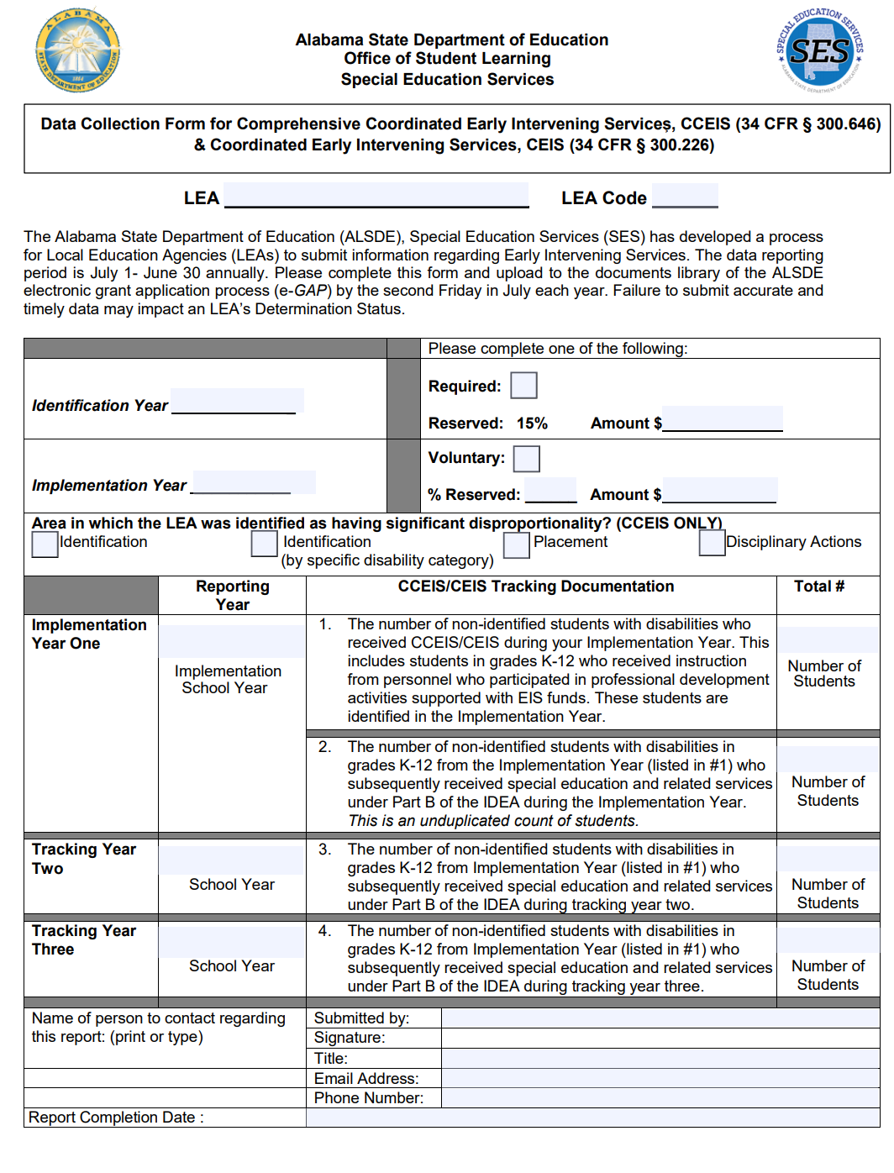
CCEIS/CEIS Reporting Form
Data Collection Window July 1- June 30
If applicable, submitted annually the second Friday in July
Notes:
To document and report the local education agency (LEA) identified as providing early intervening services, what year it was implemented, tracked and the number of students who were served during the reporting period of July 1- June 30.

Slide 29
IDEA Requirement LEA Maintenance of Effort (MOE) Requirement
What is MOE?
An IDEA requirement to ensure a LEA receiving IDEA Part B funds, spends and maintains at least the same amount of state and/or local funding for special education and related services fiscal year to fiscal year.
Who needs to meet MOE?
Any LEA that receives IDEA Part B funding
Notes:
Steady and consistent state and local LEA expenditures for special education and related services fiscal year to fiscal year.

Slide 30
LEA Maintenance of Effort (MOE) Requirement
What is MOE based on?
The State Fiscal Year (FY) and aligns with the Federal Fiscal Year (FFY) and School Year (SY).
FFY period: October 1st - September 30th
Alabama FY period: October 1st - September 30th
Alabama SY period: August - May
Example: AL FY2021 = FFY2020 = SY 2020-2021

Slide 31
LEA Maintenance of Effort (MOE) Requirement
What is included in MOE?
State and/or local expenditures related to providing special education and related services.
**Based on expenditures not revenues!**
What is not included in IDEA LEA MOE requirement?
Federal expenditures
CEIS expenditures
Reimbursements from Medicaid or other
federal funds

Slide 32
LEA Maintenance of Effort (MOE) Requirement
What are the MOE Requirement Guidelines?
The MOE requirement has two parts:
Part 1: Eligibility Standard- is completed around July-September around the time the electronic Grant Application Process (eGAP) is completed. LEA’s must show they are budgeting enough to meet the MOE requirement for the upcoming FY.
Part 2: Compliance Standard – is completed in October-November after the FY has ended, the annual report is done, and is based on actual expenditures. LEA’s must meet this requirement, or they will have to pay back the ALSDE the shortage using non-federal funds.
Notes:
Also, check for possible MOE exceptions during the MOE prong 2

Slide 33
LEA Maintenance of Effort (MOE) Compliance Component:
How does an LEA meet MOE?
Four ways:
Local funds only
The combination of state and local funds
Local funds per capita
The combination of state and local funds per capita
*Note: Meet compliance with 1 of the 4 ways
Notes:
Slide

Slide 34
LEA MOE Exceptions
34 CFR 300.204
Include:
The voluntary departure (by retirement or otherwise) or the departure for just cause of special education and related services personnel.
A decrease in the enrollment of children with disabilities.
Children with disabilities that have an exceptionally costly program (e.g., left the LEA, aged out, or no longer need the program).
The termination of costly expenditures for long-term purchases (equipment, construction, etc.).
The assumption of cost by the high-cost fund which is operated by the state.
Notes:
Here is a list of MOE exceptions for reference.

Slide 35
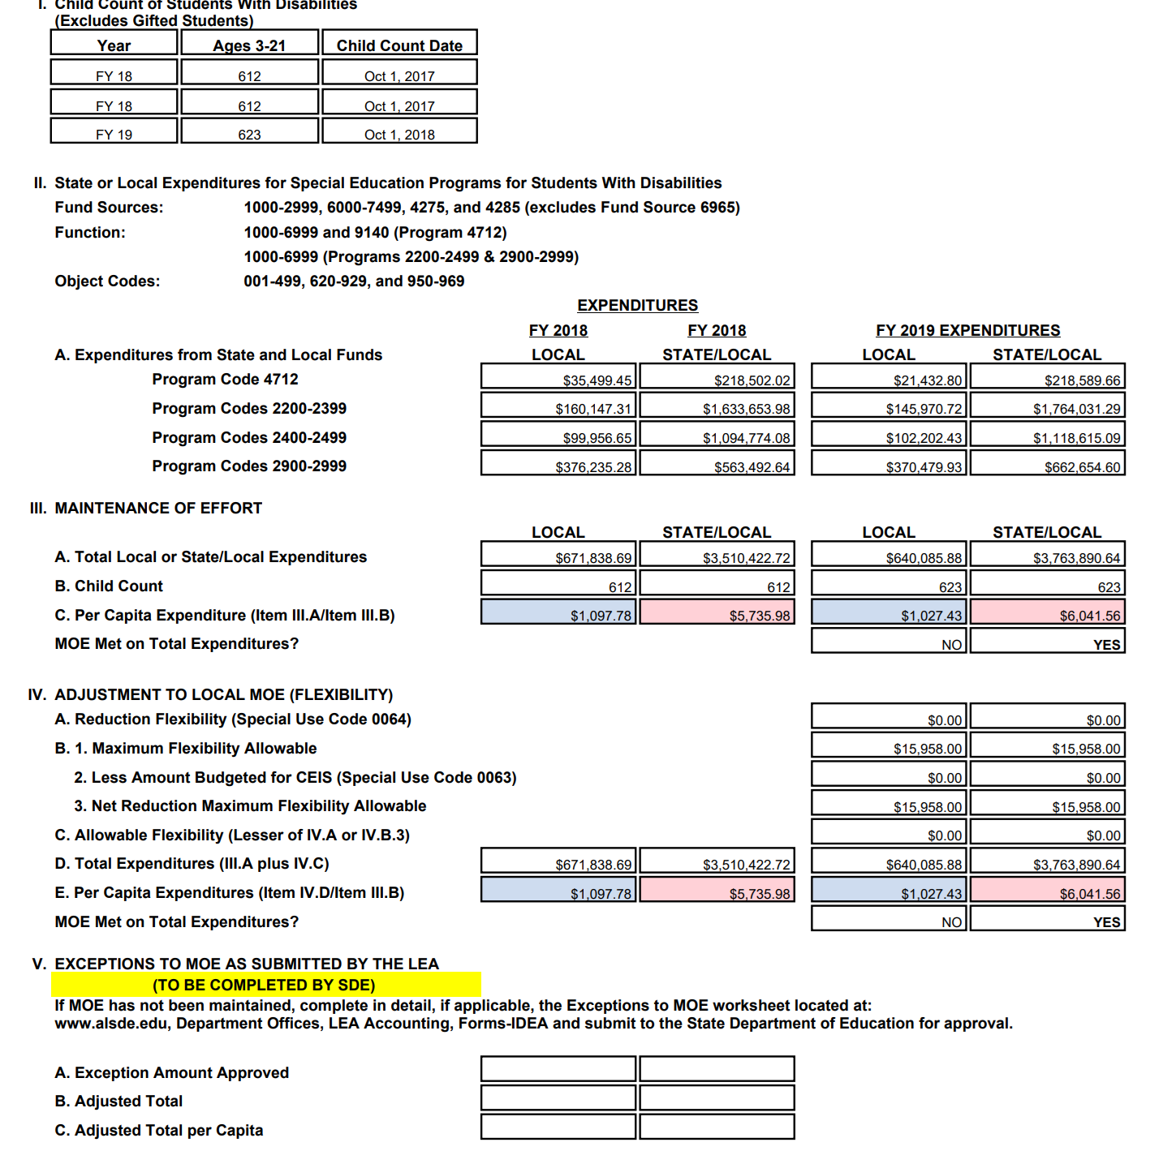
LEA MOE Report

Slide 36
IDEA Requirement Supplement Not Supplant
IDEA Part B funds must supplement state, local and other federal funds used for providing special education services not supplant those funds.
Note: Designed to ensure Part B funds are used to
pay for something “EXTRA”
If an LEA meets MOE, then the LEA meets supplement not supplant requirement.
34 CFR 300.202
Notes:
Remember students with disabilities are general education students first and the IDEA funding provided must be used to supplement state, local and other federal funds used for providing services to children with disabilities, and not supplant those funds. Part B funds are designated to be used for something extra. So, if an LEA meets MOE, then the LEA meets the supplement not supplant requirement.

Slide 37
IDEA Part B and Preschool Funding
Both the SEA and LEAs are responsible for monitoring the use IDEA funds.
Internal Controls are a key component of Fiscal Management and responsibility for compliance and successful outcomes.
Notes:
Monitoring the use of IDEA funds and ensuring all written policies and procedures are up to date is key. It is best practice to have Internal Controls, such as collaborative financial meetings occur at least quarterly between the superintendent, chief school finance officer, special education director/coordinator, and even the bookkeeper to ensure funding regulations and requirements are being followed and in compliance.

Slide 38
Budget Requirements
Electronic Grant Application Process
eGAP is the Federal Programs Consolidated Application, as well as the funding applications for Career Technical Education, Safe and Drug-Free Schools, Special Education, and Technology Initiatives.
The eGAP system allows LEAs to:
Submit applications
Develop plans
Request funding
Provide electronic avenue to complete expenditure reports
Meet monitoring requirements

Slide 39
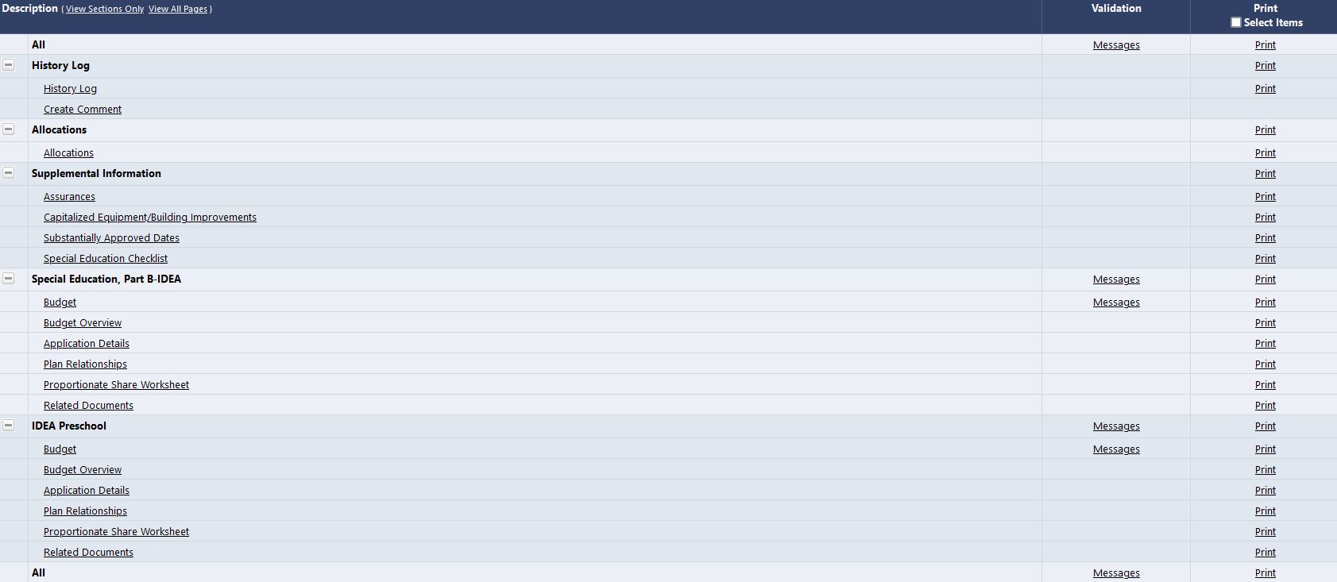
Sections

Slide 40
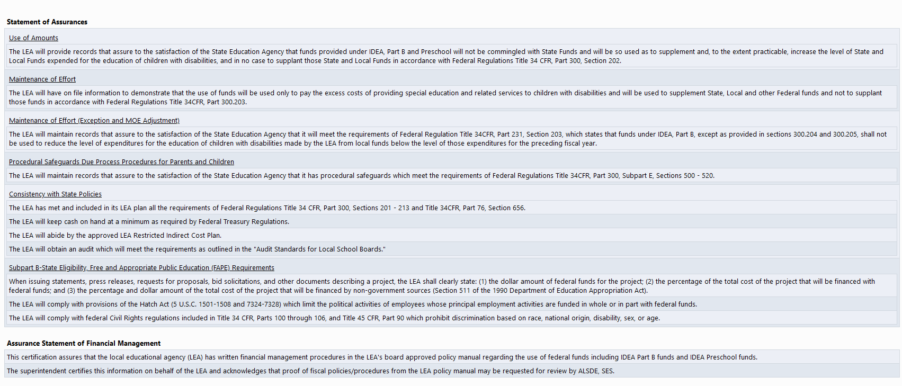
Supplemental Information

Slide 41
Budget Line Item
Notes:
Click on Add Budget Line Item

Slide 42
Deadlines and Commitments
All eGAP 2.0 IDEA budgets for FY24 must be submitted to the Alabama State Department of Education, Special Education Services by, September 15

Slide 44
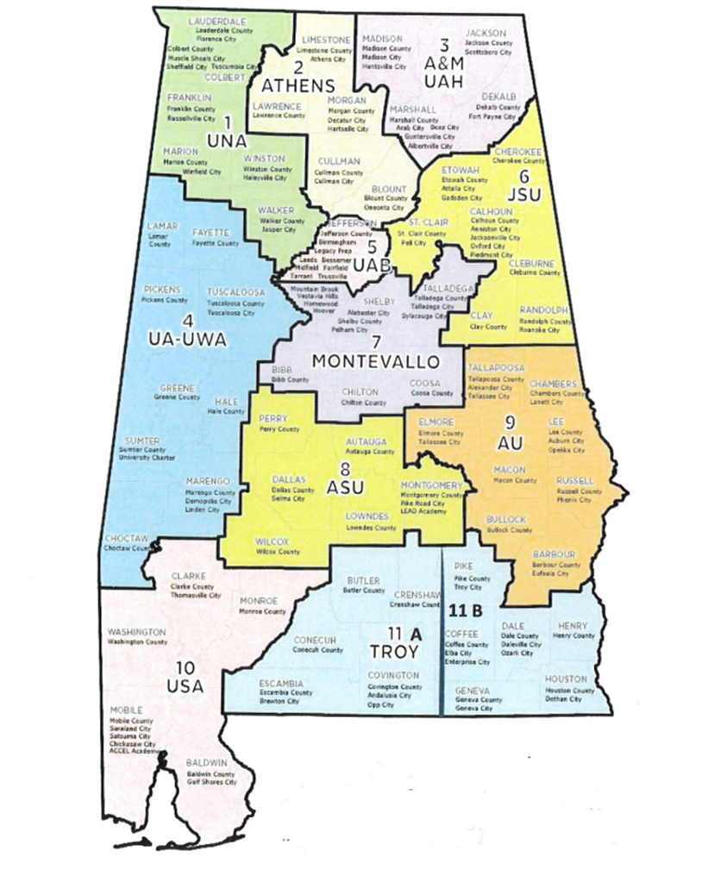
and…PRESENTING YOUR REGIONAL FISCAL SPECIALISTS
Dr. Curtis Gage
Regions 2,3,5 & 6
Ms. Camilla Gibson
Regions 7,8,9 & 11
Dr. Sabrina May
Regions 1,4 & 10

Slide 45
ALSDE, Special Education Services
Fiscal Management Team
If you need assistance, contact your Regional Fiscal Specialist at 334-694-4782 or via email:
Erika Richburg erichburg@alsde.edu
Curtis Gage cgage@alsde.edu
Camilla Gibson cgibson@alsde.edu
Sabrina May smay@alsde.edu
Notes:
The fiscal team is divided by regions to assist LEAs with Fiscal questions or concerns. We are just a phone call or email away, and are happy to assist.
The Regional Fiscal Contact by assignment are as follows:
Dr. Sabrina May and I share as SES Fiscal Contact for Regions…1, 4, 10
Mr. Curtis Gage is the SES Fiscal Contact for Regions 2,3,5,6
Ms. Camilla Gibson is the SES Fiscal Contact for Regions 7,8,9,11

